Slide 1
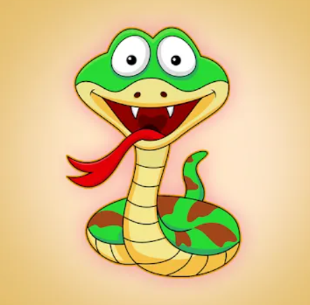
Snake Game By Python

Slide 2
INTRODUCTION
This game has been around since the earliest days of home computing and has reemerged in recent years on platforms
The game we will be building is a simple Snake game. Based on python3. In this game you control an ever-growing snake. You turn the snake head left and right and try to avoid the head hitting the rest of the body or the border.
The Game written by python 3
The Game give player competitive environment by arranged the players and display the high score
We are going to start building the game with simple graphics and look some attractive

Slide 3
Python 3 libraries
tkinter
turtle
Time
Random
PIL
Pygame

Slide 4
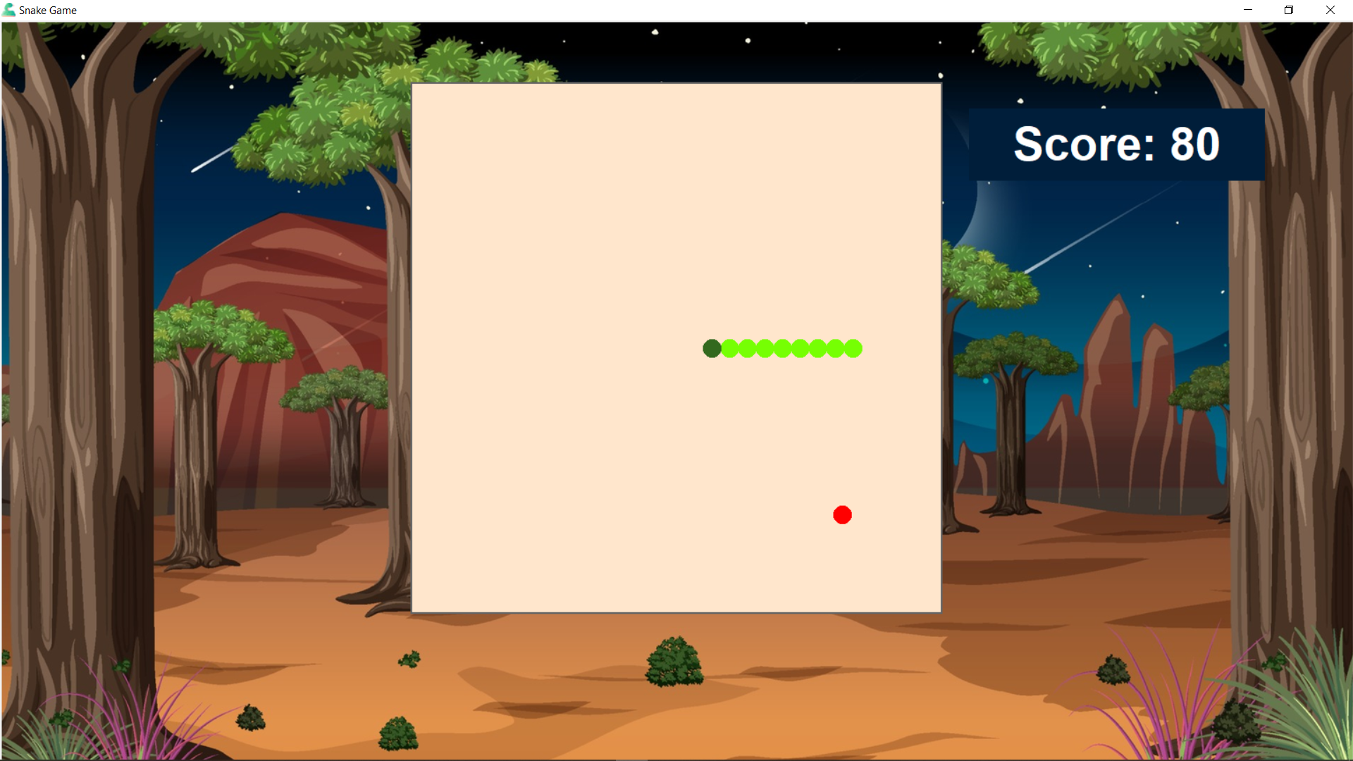
Game frame

Slide 5
Game ingredients
Main background (desert photo)
Canvas in the middle of the frame to be the snake moving area
Blue Label for display the player score
White Label will appear when the player cross the high score

Slide 6
Features
The snake move with keyboard buttons “W,A,S,D”
The Game make sound when the snake eat an apple

Slide 7
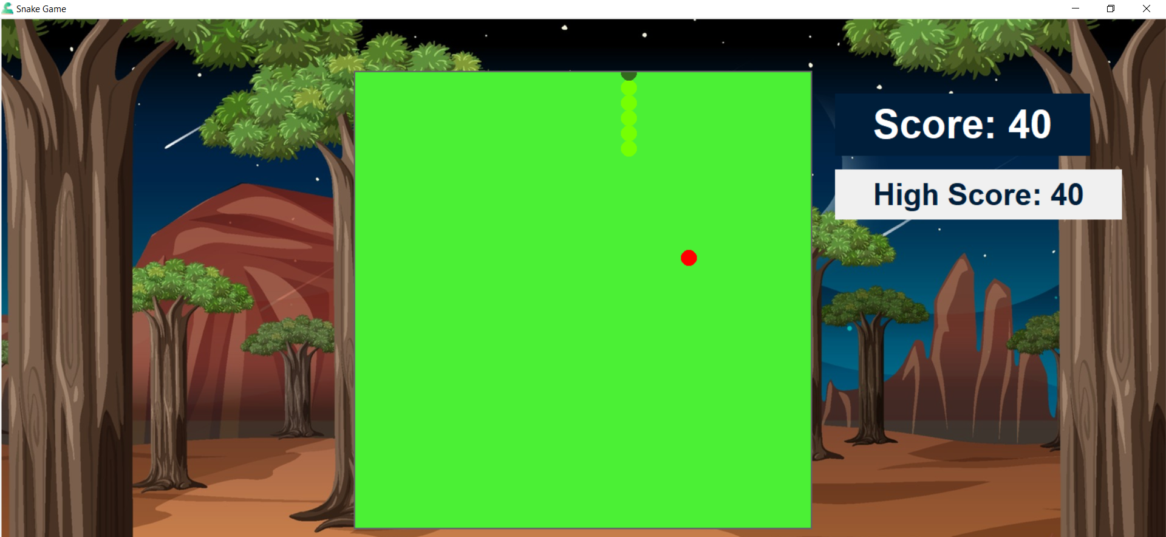
features
If player cross the high score, then die by collision the border or eat your self the screen will turn on green and give wining alarm

Slide 8
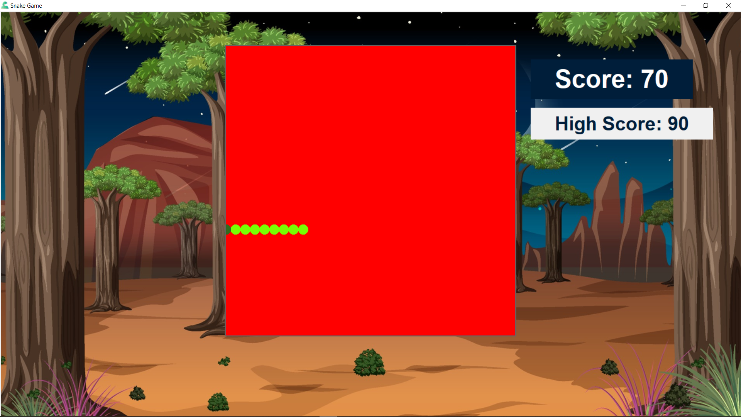
features
If you die by collision the border or eat your self the screen will turn on red and give losing alarm

Slide 9
Team members
Osama Sayed Ahmed Ashraf (Team Leader)
Ahmed Mostafa Ahmed taha
Adam Abdellatif Mokhtar
Osama Mohamed Hussein
Dina Abdullh Mohamed
Dina Mohamed Elsayed

